Slide 1

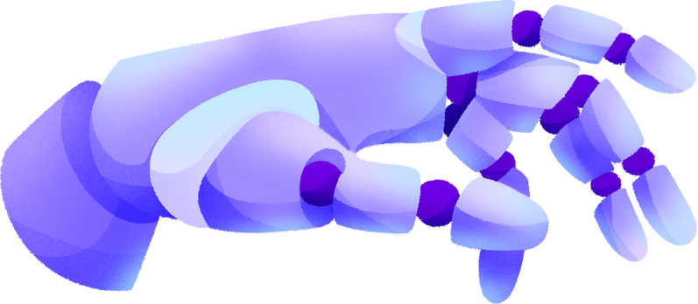
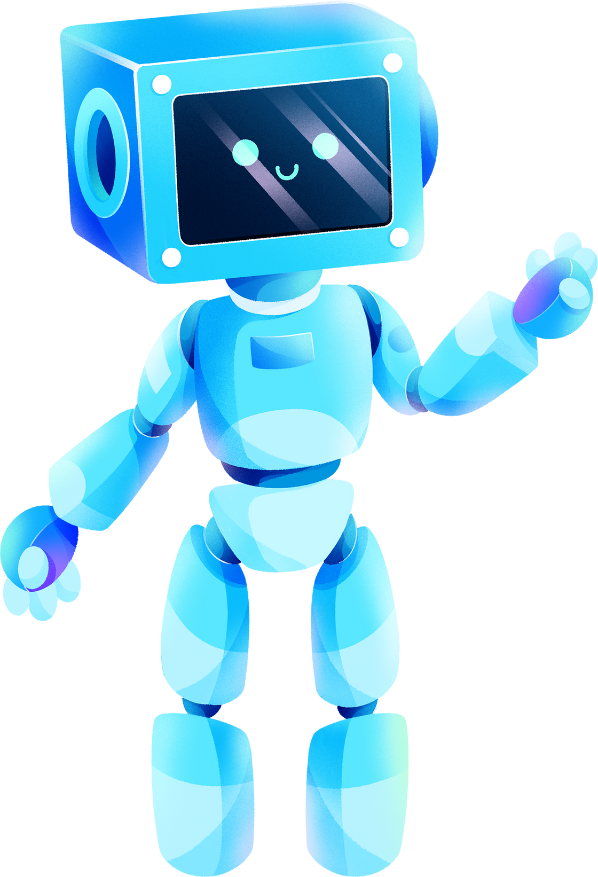


Professional Engineering Practice and Industrial Management
Group number : PEP_11
REMOTELY NAVIGATED AUTOMATED WATER QUALITY SAMPLING SYSTEM

Slide 2
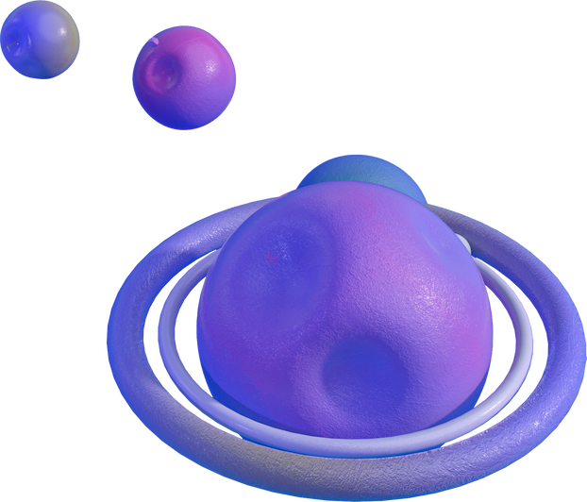
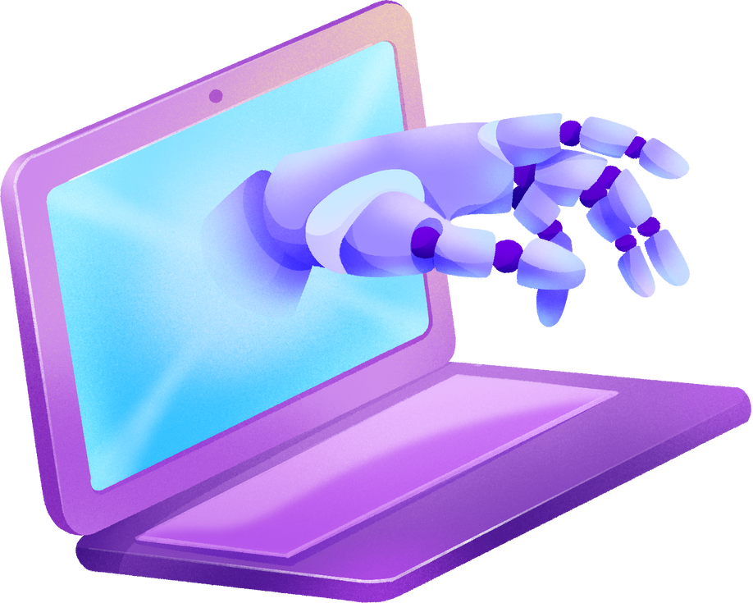
Group Member’s Details
STUDENT NAME
STUDENT NO.
CONTACT NO.
EMAIL ADDRESS
Muthukumarana T D
IT22310132
070 622 5315
it22310132@my.sliit.lk
Gayanuka Weerasekara
IT22032874
076 425 9140
it22032874@my.sliit.lk
R A S M Ranawaka
IT22320728
071 641 8341
it22320728@my.sliit.lk
R K Kaween Rashmika
IT22083050
077 177 4605
it22083050@my.sliit.lk

Slide 3


PROBLEM IDENTIFIED
Our project is driven by the critical role inland water bodies play as a source of daily water consumption.
Many of these water bodies face pollution from industrial waste and household dumping.
The widespread nature of these water bodies makes it challenging for authorities to accurately locate and monitor pollution, necessitating significant manpower and resources.
SOLUTION PROPOSED
We developed a smart solution to reduce manpower and costs, streamlining the water quality monitoring process.
Our system allows a single user to remotely record key water quality parameters and pinpoint pollution locations using GPS tracking.

Slide 4


Methodology
System Design and Development:
Develop a water quality monitoring system to be mounted on a boat.
Integrate two sensors for measuring pH value and turbidity levels.
Sensor Integration:
Mount pH and turbidity sensors on a robotic arm.
Ensure the robotic arm can be lowered to specific locations for readings.
GPS Integration:
Include a GPS tracker to record real-time location data for each measurement.
Data Collection and Storage:
Record water quality data along with GPS coordinates.
Store all data in a centralized database with timestamps.
Data Access:
Develop a mobile app and desktop app for user access.
Allow users to view and analyze water quality data, locations, dates, and times.

Slide 5
Methodology
System Deployment:
Mount the system on a boat for operation in large water bodies.
Enable remote control and monitoring by a single user.
Insights and Reporting:
Provide detailed insights into water quality across different areas.
Facilitate better decision-making and targeted actions based on data.

Slide 6

MAIN FUNCTIONS
01
02
03
04
05
Robotic Arm building & programming
Programming the Turbidity Sensor
Programming the PH Sensor
GPS Tracking System
Building Desktop Application

Slide 7

THANK YOU!

